Slide 1
Identifying Seattle Real Estate Parcels for Redevelopment
Ross Frischmuth

Slide 2
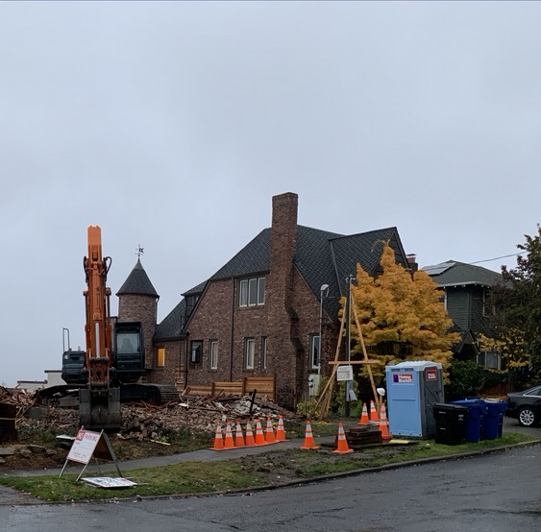
Problem Statement
Am I going to be living in a construction zone in the next few years?

Slide 3



Data Sources
King County Department of Assessments
Property value, zoning information, unit information
City of Seattle
Land use permits
King County GIS Center
Parcel Information
Notes:
GIS – Information about the land
Assessments – Information about the buildings
Inspection – Applied and approved demo permits

Slide 4
Data Set
161,521 rows x 21,149 columns
Rows: Land Parcels
Columns: Numerical and Categorical Parcel Characteristics
754 residential parcels slated for demo
No historical data – only current buildings
Notes:
Restricted to Residential in the City of Seattle

Slide 5
Models
K-Fold Splits
10 Folds
predict 10% of parcels at a time on 90% of training data
Repeat 10 times to get predictions on all parcels
Random Forest
Memory overload on local machine
Logistic Regression (first model did 70/30 train/test)
Score with area under curve of ROC (receiver operating characteristic) curve
AUC = .507 – Really bad
Logistic Regression
Proof of Concept
10% of data
Random Forests
Predict demo probability for every parcel
10 models, each with 90% train, 10% test

Slide 6
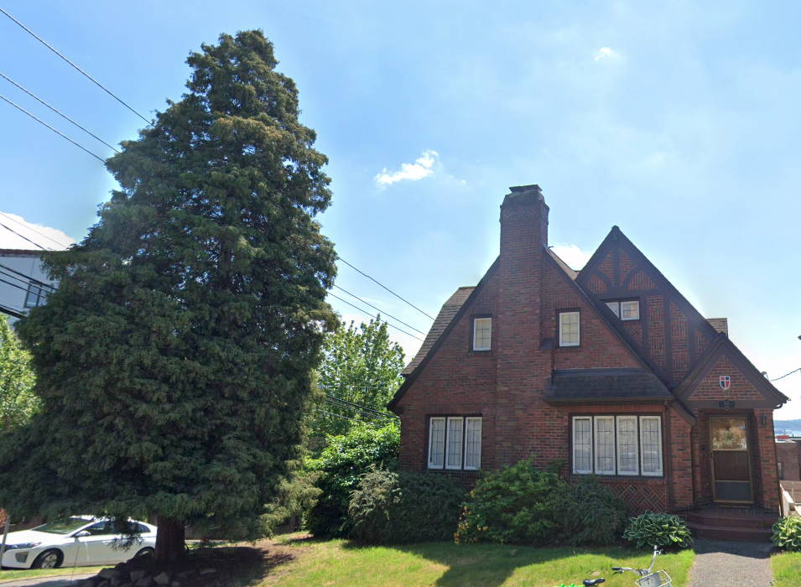
Logistic Regression Results
59 False Negative
10 False Positives
One false positive was house that was just torn down across the street from my house.
Likely overfitting or data leakage

Slide 7
Random Forest Results
Predicted Probabilities between 0 and 10% for all parcels
ROC AUC: 0.69

Slide 8
Scoring
How well did model identify true positives?
Which properties are good candidates?
Cannot predict other factors influencing if a particular owner might sell.

Slide 9
Next Steps
K-Fold Splits
10 Folds
predict 10% of parcels at a time on 90% of training data
Repeat 10 times to get predictions on all parcels
Random Forest
Memory overload on local machine
Logistic Regression (first model did 70/30 train/test)
Score with area under curve of ROC (receiver operating characteristic) curve
AUC = .507 – Really bad
Incorporate historical property values into model
Build map application
Create address search functionality

Slide 10
Thank you
Ross Frischmuth

Slide 11
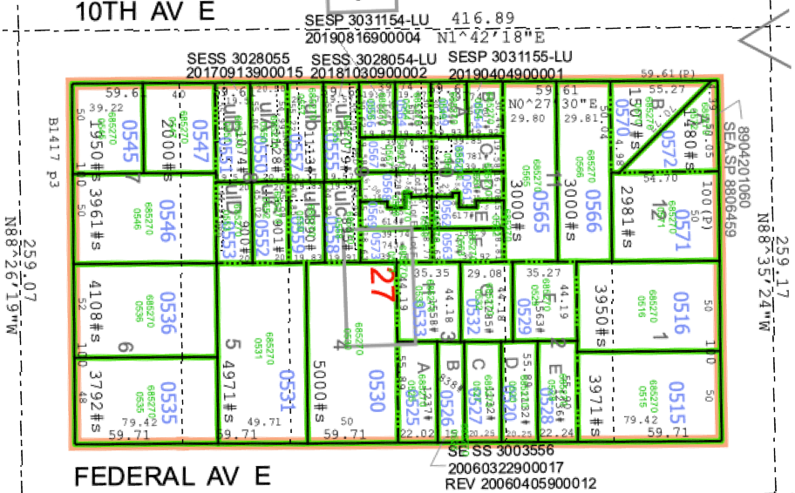
Deliverable
Display probability a specific parcel will redevelop
Assign value to property reflecting aggregate probability neighbors will redevelop

